Slide 1
Building Flatpak apps with BuildStream!

Slide 2
Building Flatpak apps
Use flatpak-builder
Use Flathub
Use flatpak-dev-cli

Slide 3
...but you could use BuildStream
It’s being used for SDK development
It’s pluggable & can produce any kind of output
It scales
You will be able to contribute improvements :-)

Slide 4
Examples
NetSurf:
https://gitlab.com/BuildStream/buildstream-examples
GNU Hello
https://gitlab.com/valentindavid/org.gnu.Hello/
Tagcloud
https://gitlab.com/samthursfield/tagcloud

Slide 5
Details
Project structure
  project.conf
  elements/
    gnome-{platform,sdk}.bst
    app dependencies
    tagcloud.bst
    flatpak-integration.bst (workaround bst-external issue #10)
    flatpak-*.bst
      metadata follows http://docs.flatpak.org/en/latest/manifests.html
  deploy.sh

Slide 6
Local builds
bst build tagcloud-flatpak.bst
./deploy.sh
flatpak run uk.me.afuera.Tagcloud
Cycle time of about 30 seconds
~/.cache/buildstream about 7.1GB

Slide 7
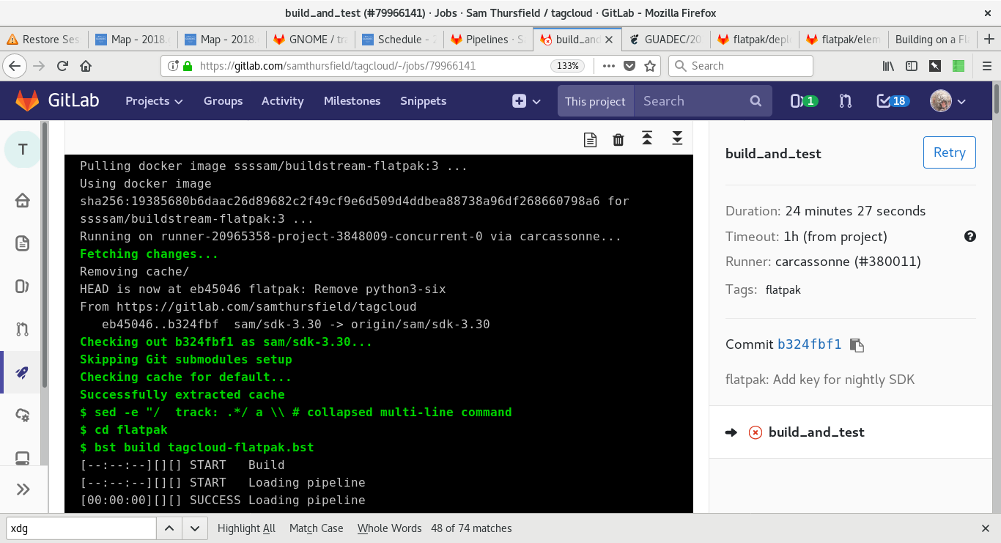
Automated builds

Slide 8
Automated builds
GitLab CI has a cache
… but it only scales to 1 or 2 GB of data
… and it loses your xattrs and breaks OSTree
Current solution:
GitLab caches ~/.cache/buildstream/source
CI builds take about 20 mins
BuildStream artifact cache for build results...
no timings due to buildstream issue #460

Slide 9
Test environment
Add test dependencies to a separate element
and run tests inside `bst shell`
This can also be used to run the app from the source tree for fast cycle time, debugging, etc.

Slide 10
Publishing
No Flathub :-(
Need to host your own OSTree repo.

